Slide 1
Welcome
Dr Sharon Redrobe OBE
Chief Executive, Twycross Zoo

Slide 2
The wider tourism context
Where does this DMP sit within the sub-region and beyond?

Slide 3
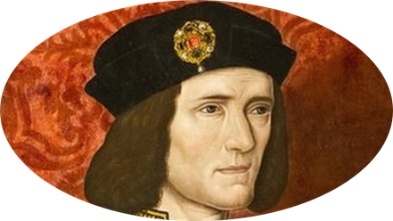

Slide 6
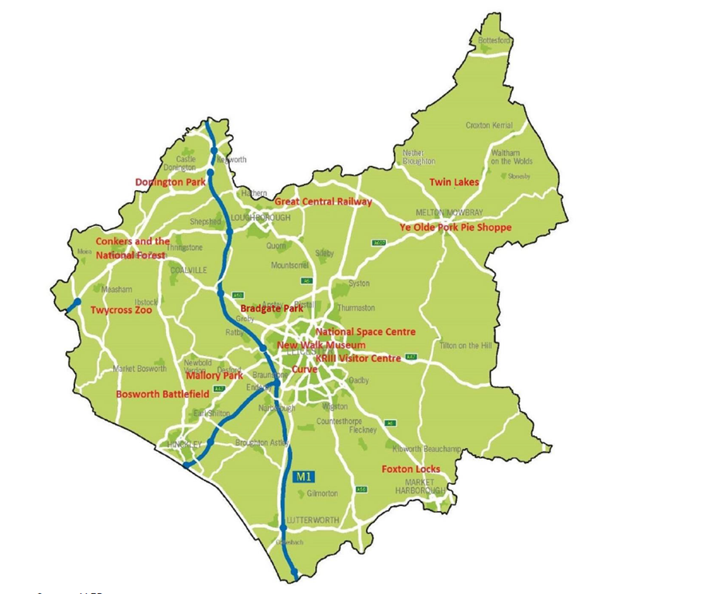

Slide 7
How can this growth potential be realised?
Enhance our destination marketing
Ensure the key infrastructure can sustain growth potential

Slide 8
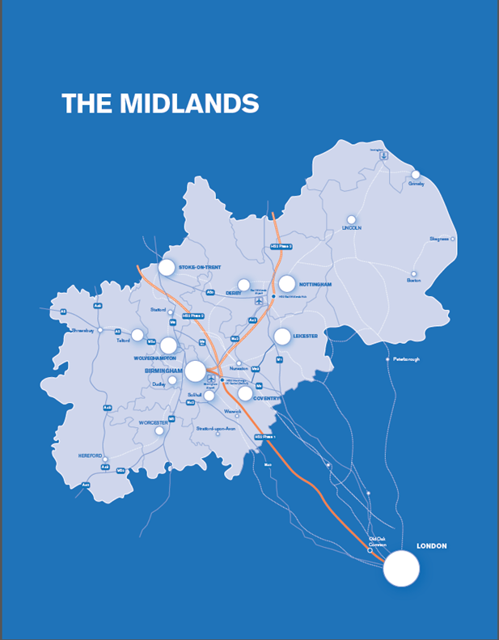

Slide 9
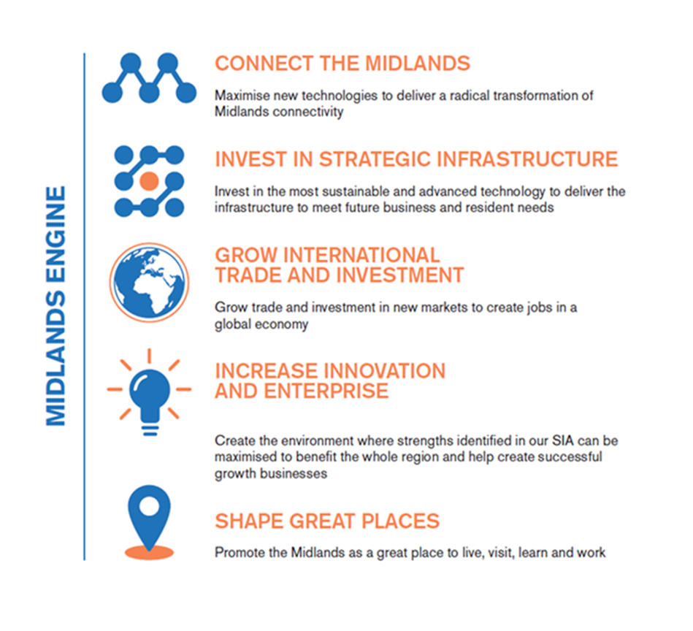

Slide 10
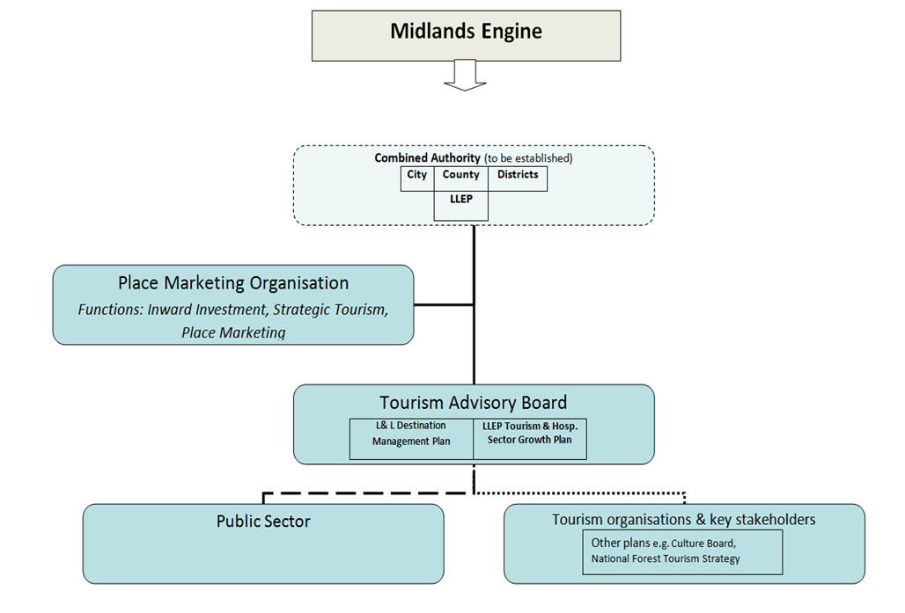

Slide 11
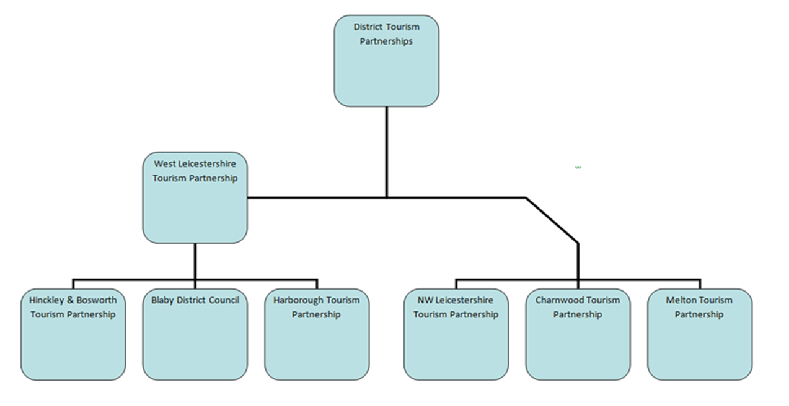

Slide 12
Thank You
Please provide your feedback and obtain copies of this presentation at:
www.leicesterbusinessfestival.com

